Slide 1


AEE Middle Tennessee – April 2025 Chapter Meeting Updates
Association of Energy Engineers

Slide 2
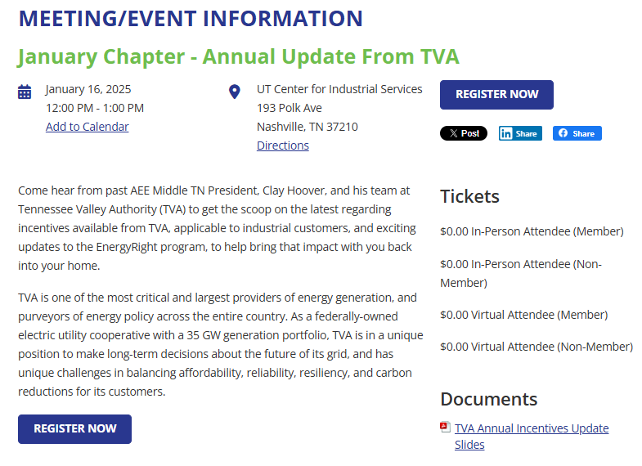
AEE Middle TN – March Chapter Meeting Updates
New Website: AEEMiddleTN.org
New LinkedIn: AEE Middle TN Chapter
Board Opportunities Available
  Treasurer
  Media Chair
Chapter slides available via our website URL above:
  Meetings → Previous Meetings → Click “View Details” for the relevant chapter → the slides will be stored under “Documents”
Your feedback means everything
Golf Tournament: Confirmed August 7th @ Pine Creek
Upcoming Meetings – Save the Date!
  Thursday, May 15th, 12 – 1 PM
    Topic: Unleashing the Power: AI's Leap into Energy Management
    Speaker: Ivan Ospina, CEO & Founder, Qubits Energy
    Location: In-Person Only at UT CIS, 193 Polk Ave
  Save the date – next meetings
  Thursday, June 12th, 12 – 1 PM
    Topic: Building Performance Standards: Evolution & Updates
    Location: In-Person Only at UT CIS, 193 Polk Ave
    Speaker: Marla Thalheimer, Sr. Director of Business Engagement, Institute for Market Transformation

Slide 3

Marketing Yourself to the Energy Industry

Slide 4



Nenni and Associates
United States focused recruiting firm in the energy services space. We are based in Chicago with nearly 25 recruiters dedicated to securing talent in sustainability for 30 years.
Ryan McGushin Paul Copper
Notes:
These are the core areas that members can engage in

Slide 5
Agenda
Introduction
Networking
Industry Trends
Owning Your Career
Offer Negotiation
Q & A
Notes:
These are the core areas that members can engage in

Slide 6
How Do We Network
AEE events and local chapter
Other Trade Organizations
Linkedin
Talk with recruiters
Intentional efforts/Follow-up
Mentor
Get involved with your alma mater
Notes:
These are the core areas that members can engage in

Slide 7
Industry Trends
Government efficiency/Federal downsizing
Industry Shifts
New technologies and AI
Private Equity
Compensation Trends
Shortage and needs for talent
Notes:
These are the core areas that members can engage in

Slide 8
Industry Career Opportunities
Industry Career Opportunities
Notes:
These are the core areas that members can engage in

Slide 9
Industry Trends - Remote Work
Company shift to hybrid or in office
Advantages versus disadvantages
Role differentiation – engineering, leadership versus operations and sales
Consider thriving markets and relocation

Slide 10
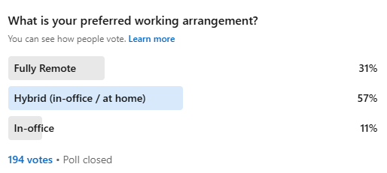
Work Location Preference
Notes:
These are the core areas that members can engage in

Slide 11
Own Your Career
What do you love about your career?
Notes:
These are the core areas that members can engage in

Slide 12
Own Your Career
5 year and 10 year career plans
Further your education
Resume
Career muscles
Stay ahead of the curve
Soft skills
Notes:
These are the core areas that members can engage in

Slide 13
Offer Negotiation
Selecting your best opportunity
Timing of offers
Communication
Counteroffer

Slide 14
Q & A

Slide 15
Thank You!

