Slide 1


FY26 Program Enhancements
October 2025

Slide 2
Agenda
Year in Review
Value of PPN
PPN Awards
Updated Incentives
Next Steps

Slide 3
Year in Review

Slide 4
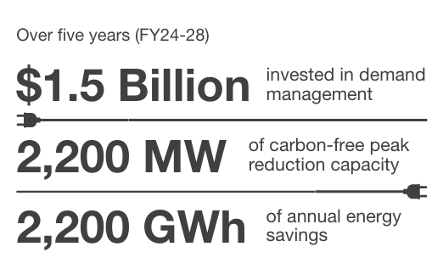
FY25-29 Portfolio Investment & Impact
$43,000,000
Over five years (FY25-29)
$1.9 Billion
$783,000,000
2,800 MW
2,100 GWh
of net annual energy savings
$1,119,000,000
Demand Response
Energy Efficiency
Peak Load Management

Slide 5
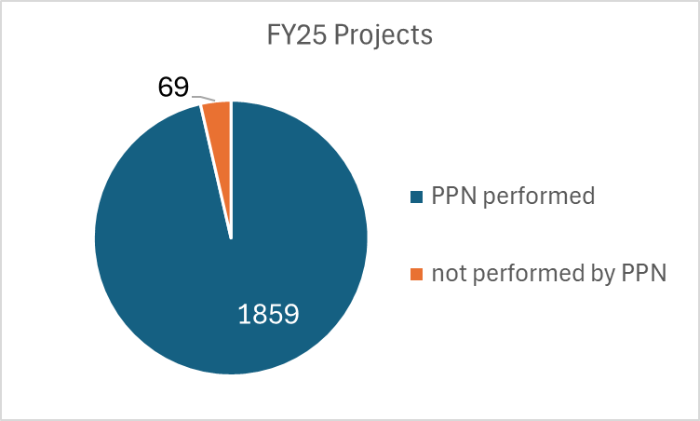
Value of the PPN
Procures and installs energy savings technologies
Completes incentive applications for customers easing their paperwork burden
Understands Program rules and requirements, making project submissions easier
Already selling these technologies to our customers. Program becomes an extension of your sales team!
Business Developers are here to:
Help guide you to the best possible solution for your project!
Ensuring projects maximize their incentive and are processed smoothly.
96% of all base program projects in FY25 were performed by a PPN
Notes:
PPN are free marketing staff a free sales team

Slide 6
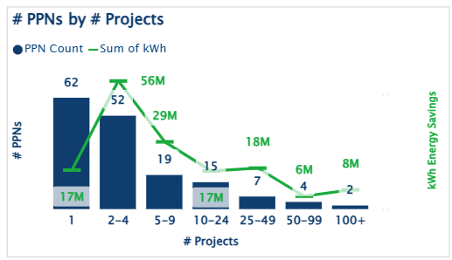
PPN Insights - Dashboard View
Most PPNs will only submit 1-4 projects in a single year.
How can we help? Let’s find a way to get more projects submitted for your company!
Notes:
Ruchi and Danielle built in FY25 – new insights are already paying dividends
MODIFIED CHART, removed the non-base programs from PPN dashboard. This chart shows the base program only projects performed by PPNs in FY25
The PPN dashboard (that has this chart) is a collection of jobs that have and "should" complete in FY25.
The 50-99 range represents PPN that do high volume of smaller projects (fast track lighting, school projects which are lower GWh).

Slide 7
Current PPN Status
Big growth in PPN activity level
PPN attrition:
  2018 before electrification - 600
  2021 COVID program halt - 159
PPN enrollment since relaunch:
  2023 relaunch - 314
  Nov 2024 – 400
  Today we have 447 PPN!
#PPN submitting projects
Notes:
Percent PPN who submitted projects, 2023 = 29%, 2024 = 33%, 2025 = 38%
Onboarded ~100 new PPN in FY25, 35% submitted a project
Next year goal to get 50% of new PPN to submit projects
PPN membership lasts for 12 months. When those 12 months are over then we ask them to renew and send us their Business License and Proof of Insurance and we tell them about our training resources

Slide 8
FY25 PPN Awards
Excellence in Region
Excellence in Technologies
Rookie of the Year
Best Use of Our Marketing Tools
Closest to Estimation of Completion
KY, MTN, WTN, MS, AL, NE, SE, Outside Territory
Lighting, HVAC, FTL, Commissioning, Custom, Refrigeration, VSD, Compressed Air, New Construction Lighting
PPN awards are back for FY25!
We want to acknowledge our highest performing vendors for the following categories
Award winners have been contacted for a special lunch! We look forward to celebrating with you.

Slide 9
PPN 2025 Awardees
Excellence in the Technology
Excellence in the Region
Refrigeration: Benchmark Group
Custom Incentive: Trane Nashville
Standard HVAC: Lee Company
VFD: Mechanical Resource Group
Standard Lighting: Skilled Services
Fast Track Lighting: ROI Energy
Compressed Air: IZ Systems
Commissioning: Optimum Energy
New Construction Lighting: Relumination
AL: Inergy Solutions
KY: Cayce Mill Supply
MS: Efficient Power & Light
MTN: Trane Us – Nashville
NE: Shoffnerkalthoff MES INC
SE: Consolidated Electrical Distributors
WTN: Path Company
Outside: Ascendent Facility Partners
Other Awards
Rookie of the Year: CDFL
Best in Marketing: M&M Lighting
Closest to estimated date: Schneider Electric

Slide 10
Business & Industry
Incentive Updates

Slide 11
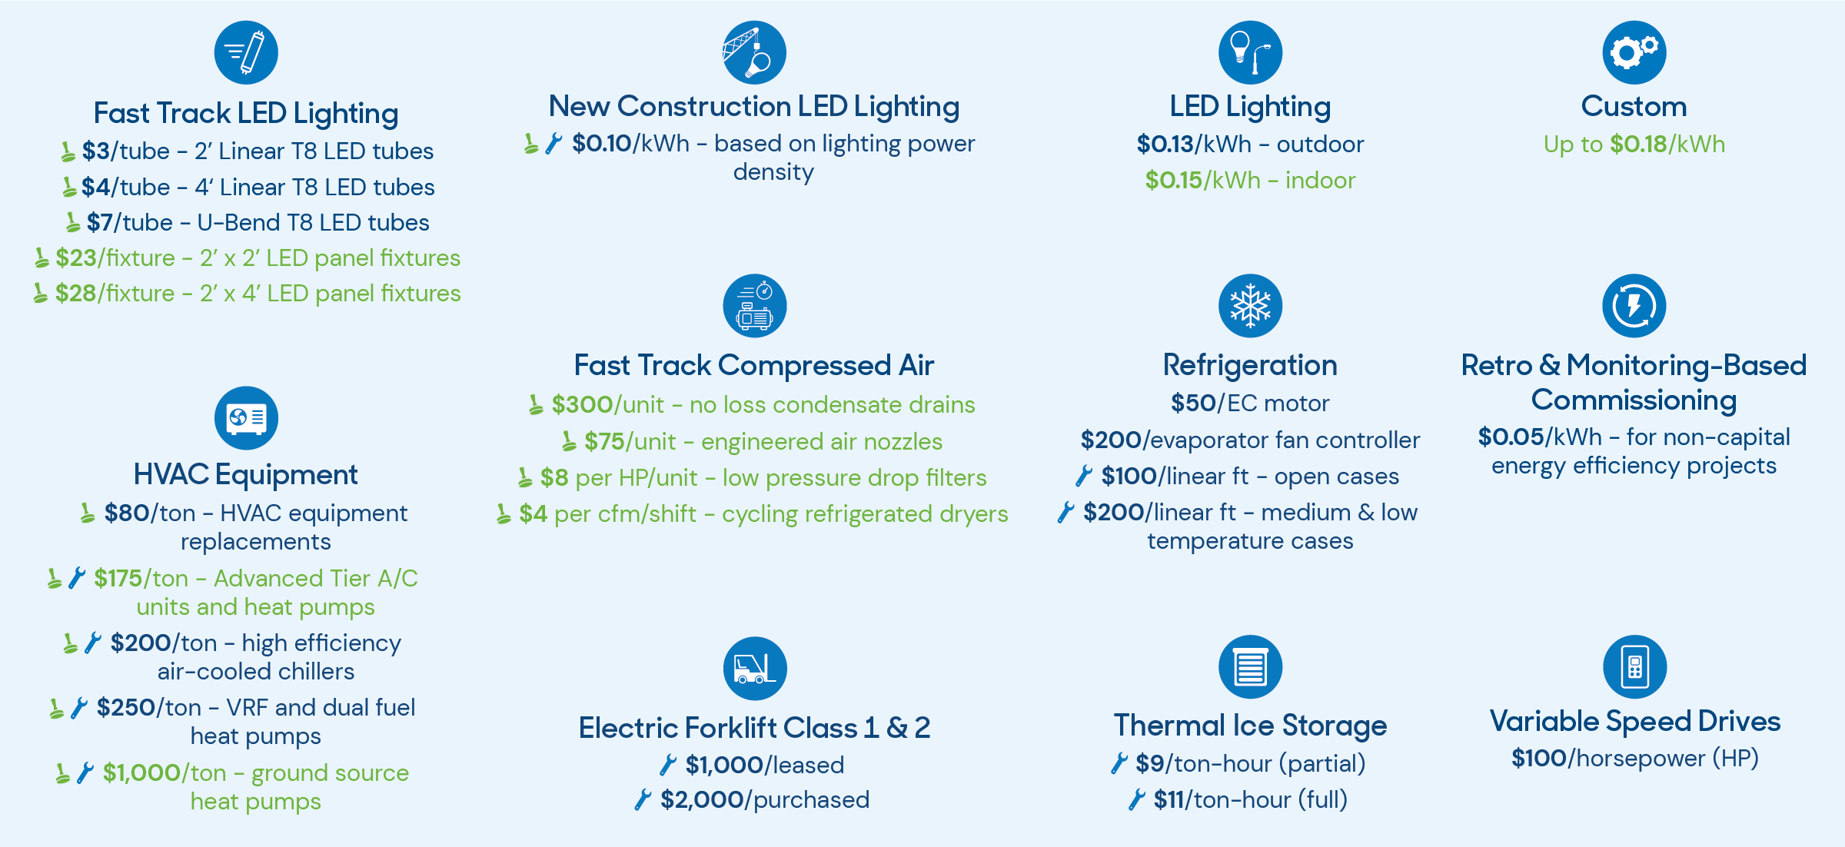


Incentives: Overview
= no pre-approval required.
= eligible for new installations in new buildings, building additions, or new equipment in existing buildings.

Slide 12


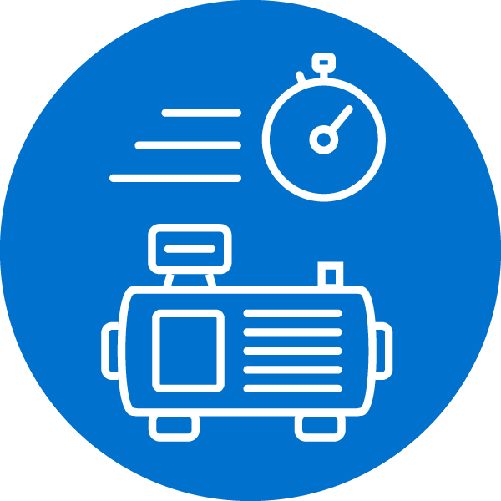

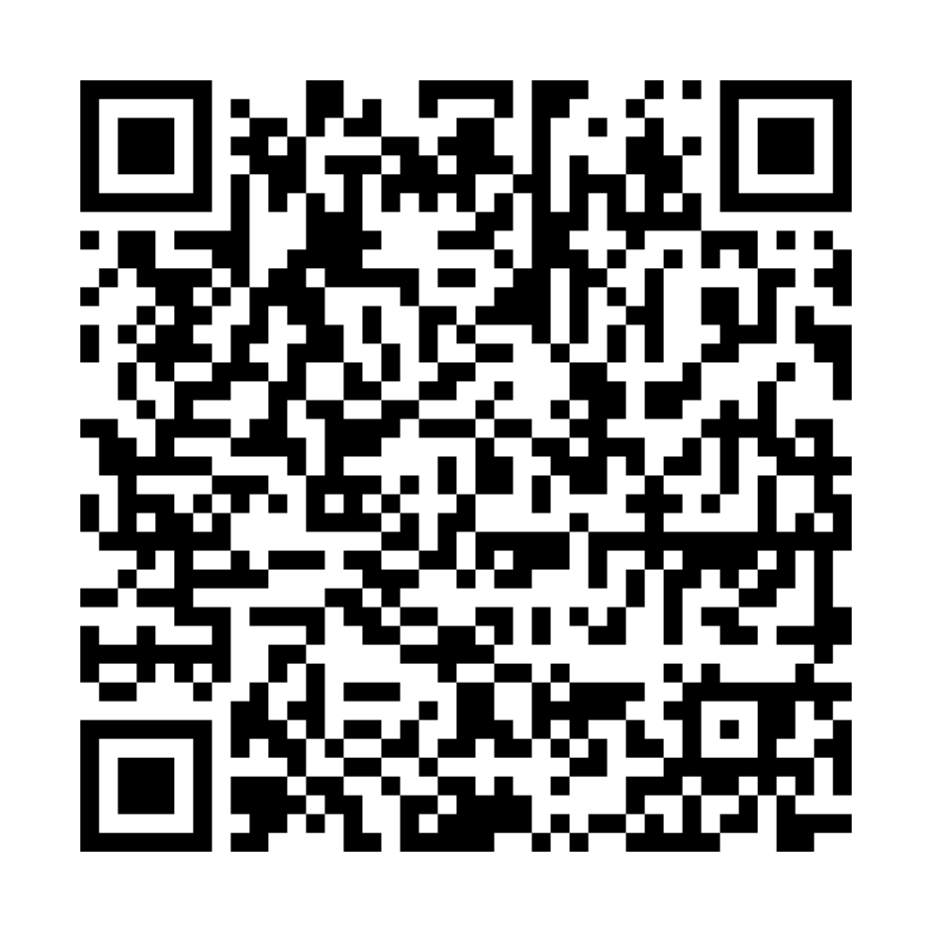
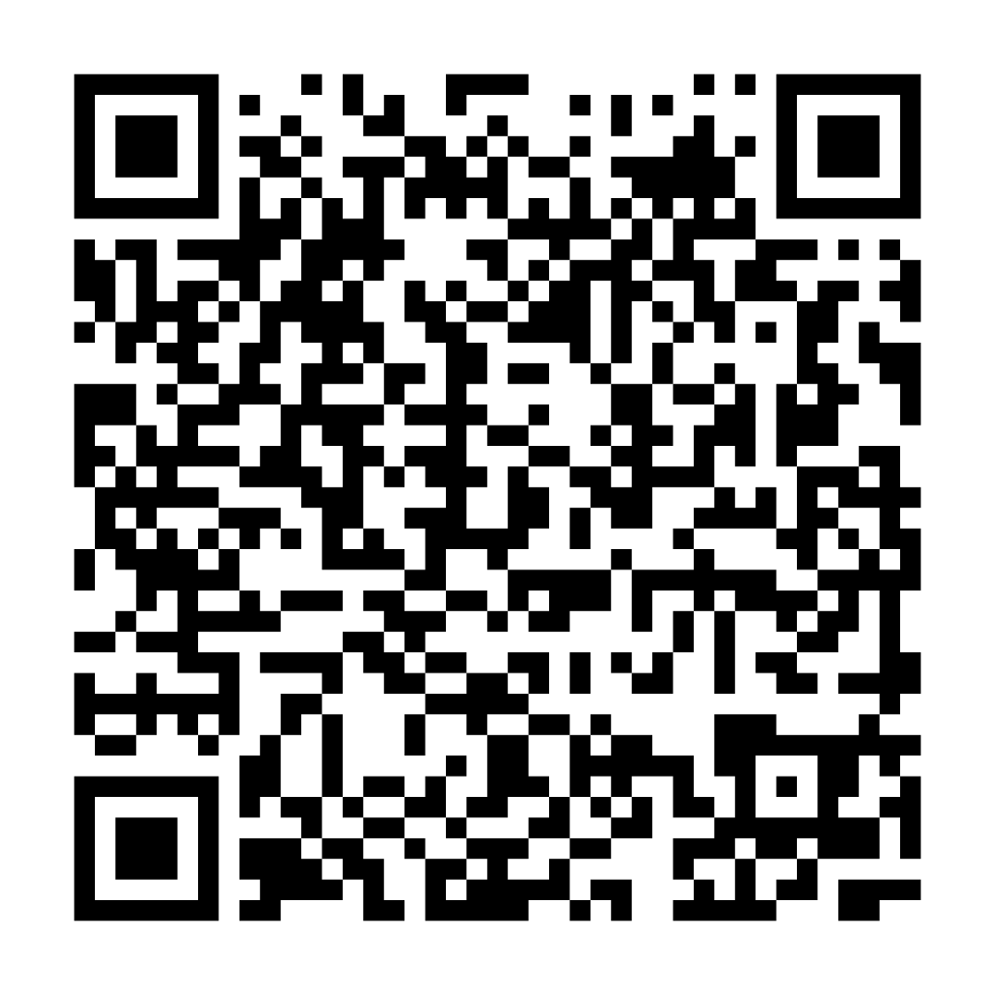
Incentives: New and Expanded Measures
New Construction Lighting
Now includes:
Major renovations with a COMcheck compliant at $0.10/kWh
Network lighting controls are now eligible and could increase incentives
HVAC
Now includes:
$175/ton for Advanced Tier heat pumps
$1,000/ton for ground source heat pumps (or geothermal HPs)
Fast Track Compressed Air
New!
$300/unit for no-loss condensate drains
$75/unit for engineered air nozzles
$8/HP/unit for low pressure drop filters
$4/cfm/shift for cycling refrigerated dryers
New Construction Lighting Incentive Calculator!
General
Incentive
Calculator!
= no pre-approval required.
= eligible for new installations in new buildings, building additions, or new equipment in existing buildings.
Notes:
COMcheck is a U.S. Department of Energy software used to demonstrate commercial building energy code compliance. Network lighting controls increase savings
HVAC – Advanced Tier HP
•Advanced Tier AC has previously been implemented by the program and HP represents a continuation of that effort
•Offers the potential for greater savings on higher efficiency installations
HVAC – Ground Source HP
•The market has expressed interest.
•This is a system we encounter frequently on schools.
Fast Track Compressed Air
•Current Fast Track format has been well received by the market
•Removes requirements for calculations and Custom minimums
•Provides additional channels for participation among Industrial customers

Slide 13



Incentives: Increases & Limited-Time Offer
Incentives increases to drive customer participation:
Indoor Lighting
$0.13/kWh to $0.15/kWh
Fast Track Lighting
2' x 2’ fixtures from $18 to $23
2' x 4’ fixtures from $22 to $28
Custom Projects
$0.15/kWh to $0.18/kWh
Receive an EXTRA 15% for incentives on following projects by applying Oct. 1 – Dec. 31:
Indoor & Outdoor
Lighting
New Construction Lighting
Custom Projects
For example, if a project incentive is $10,000, the participant will receive a bonus of $1,500 when the project is complete.
Notes:
Reasons to Increase Incentives
•TVA customer research indicates that incentives need to achieve 2-year simple payback. Even after the proposed incentive increases, our estimated simple payback will be 3.5 years.
•ERBI needs to make up an extra 100 GWh over the next 4 years.
•Typically, the pipeline is 50-60% at the start of the FY. Our current pipeline is 40% of the goal.
•Inflation continues to lessen the impact of incentives on material cost.
•Benchmarking with other utilities, the average incentive is $0.18/kWh.
Limited Time Offer
•Offers applied to project at application submission
•A limited time offer will drive participation early in the fiscal year
•It will also allow us to test out a higher incentive rate without having to commit to it long term.

Slide 14
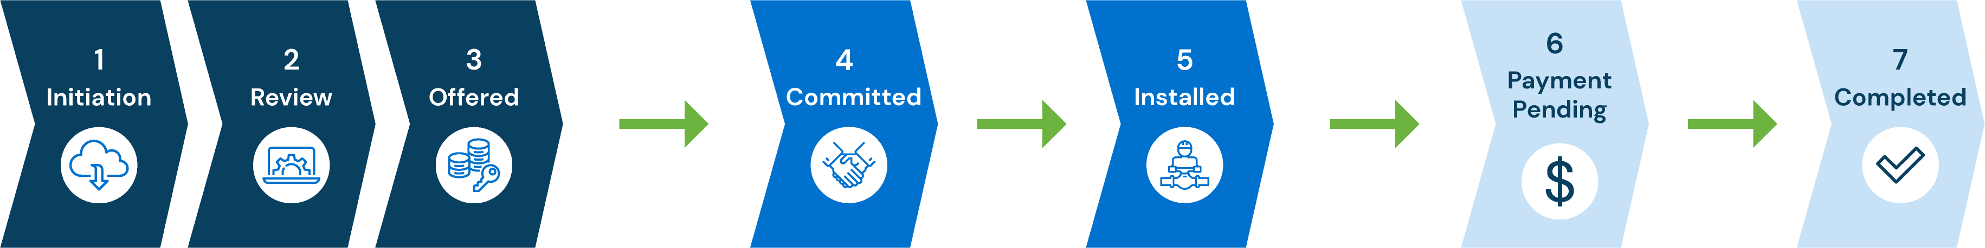
How Incentive Projects Proceed
Steps 1-3: Initiation to Offered
Online Application Received
Equipment can be ordered
Review Application & pre-project documents
  SOW, PPEC, Spec Sheets
LPC Eligibility Request
Pre-Inspection
Application Approval Notice
Steps 4-5: Committed to Install
Remove equipment
Begin installation
Notify operations when installation is complete
Steps 6-7: Payment to Complete
Receive & review post-project documents -
  Invoices
Post-project inspection
Incentive payment
  Standard method is via check
  Bill Credit from LPC if incentive >$12,000 and LPC participates in bill credits

Slide 15
Rules to Remember
Up to 730 Days for project completion
Pre-approval measures only - Do not install or remove equipment prior to application pre-approval
Pre- and post-inspections may be required
OLA & PPEC need to be submitted at the same time for lighting projects (Sub#)
Default payment method for incentives is a check
If incentives are ≥ $12,000 and your local power company participates in bill credits, you can now opt-in to bill credits on the OLA
Incentive is capped at 70% of material cost
Material project costs do not include labor and sales tax.
Standard incentive minimum is $150
Custom incentive minimum $1,500

Slide 16
PPN Rewards

Slide 17
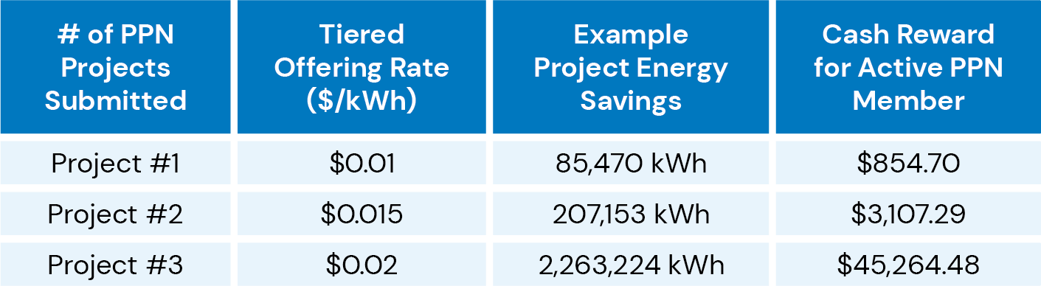
PPN Rewards – Filling the Pipeline
Conditions:
Offer for FY26 Q1 for projects submitted by December 31, 2025.
Projects paid in order they are received and processed
Available for base incentive program projects only, excludes Fast Track lighting
MAX SPIF = $50,000 per project MAX SPIF per PPN = $100K
Available as funds last
Notes:
PPN Budget for FY26 is $950,000 ($750k + $200k). This budget has been spread among the four base program categories C10, C11, C2, C3
SPIF max = $50,000 would be 5 M kWh savings project for the first project $0.01/kWh
Assumptions:
Calculations based on an average 185,000 kWh savings per PPN project
Benefits include:
Use as a recruiting tool for new PPN and to get them engaged quickly
Reward loyal PPNs by incentivizing them to submit multiple projects in on FY
Options – start in January 2026

Slide 18
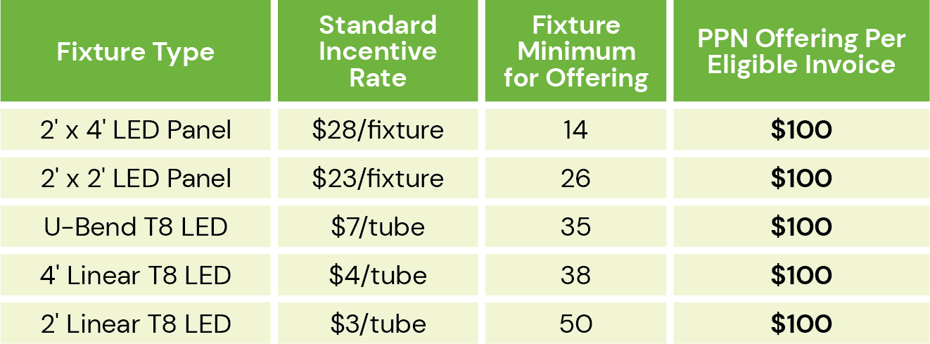
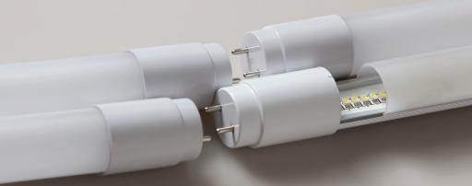
Fast Track Lighting SPIF Extension
Active PPN members are eligible to earn up to $500 for each completed incentive project for Fast Track Lighting. Payment will be provided to the PPN member in a separate check after project completion.
Rules & Limitations
Offering capped at $500 per project
Limited to $9,000 per active PPN member
Standard Fast Track Lighting incentives still apply and are paid to the company identiﬁed by the customer
Notes:
investigate if U-bend should stay

Slide 19

Next Steps:
  Review any current unsubmitted projects
  Copy and paste any unsubmitted PPECs to a new workbook to get the new incentive rate
  Let your customers know about the increased incentives
  Reach out to your BD with any questions
  Find new fact sheets and marketing material in your PPN Dashboard

Slide 20
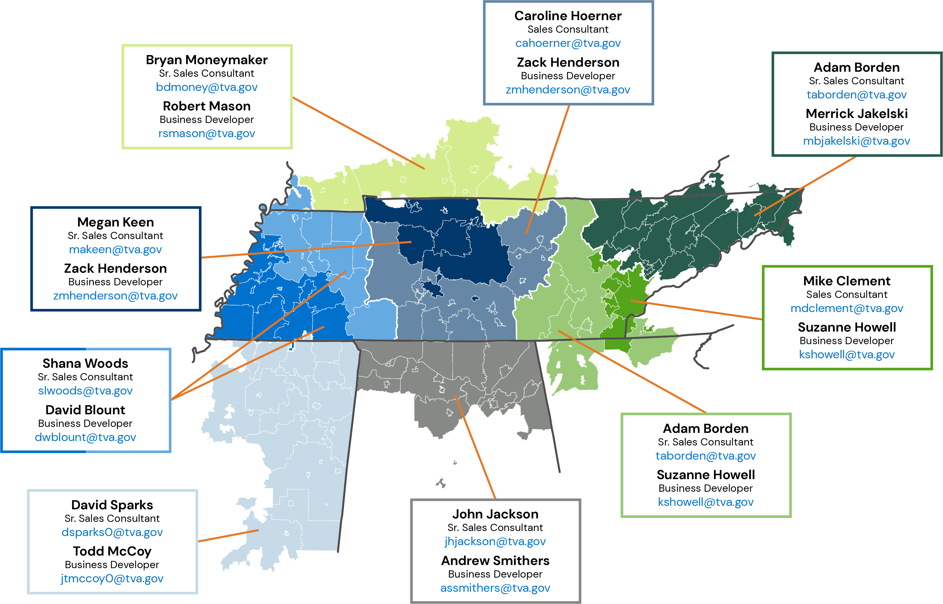

Meet the Team

